Slide 1

Embedded System Design using Sapphire RISC-V SoC

Slide 2
Objectives
After completing this module, you will be able to :
Identify some of the features of the Sapphire RISC-V SoC processor
Review embedded system Fundamentals from a hardware point of view
Review embedded system Fundamentals from a software point of view

Slide 3
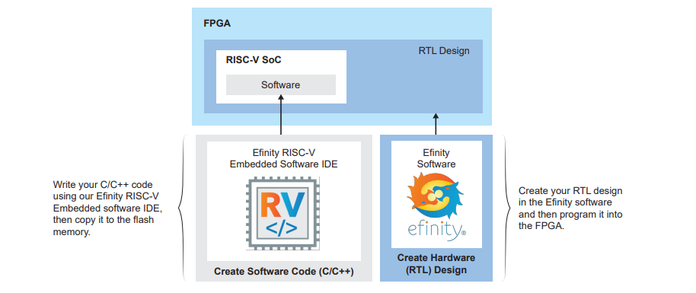
What is the Sapphire RISC-V SoC ?
The Sapphire SoC is a cached soft RISC-V SoC that optionally includes a memory controller interface.
The Sapphire SoC supports a variety of peripherals. You can choose which peripherals you want by configuring the SoC in the IP Manager. This core is similar to the open-source SaxonSOC, but it has been optimized for Trion® and Titanium FPGAs.

Slide 4
The Sapphire SoC incorporates
a 32-bit RISC-V processor,
1 - 32 KB instruction cache,
1 - 32 KB data cache,
4 - 512 KB of on-chip RAM, and a variety of peripherals (including 1 - 5 APB3 slave peripherals and 1 AXI slave).
You can configure the operating frequency from 10 - 400 MHz (the actual performance is limited by the design's fMAX).
The SoC includes 1 - 3 I2C peripherals and 1 - 3 SPI masters.

Slide 5
The default configuration has a 128-bit half-duplex AXI bus to communicate with the Efinix DDR controller or HyperRAM controller.
DDR controller:
This core uses the Trion FPGAs hard DDR DRAM interface to reset an external DRAM module (resets and re-initializes the Trion FPGA's DDR interface as well as the DDR module(s)).
HyperRAM controller:
This core controls HyperRAM memory modules. You can customize the SoC using the IP Manager in the Efinity software.

Slide 6
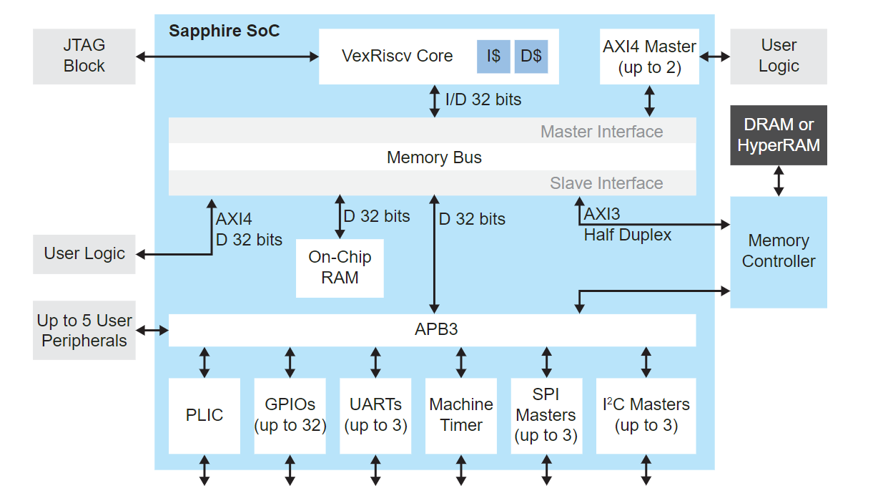
Sapphire SoC Block Diagram

Slide 7
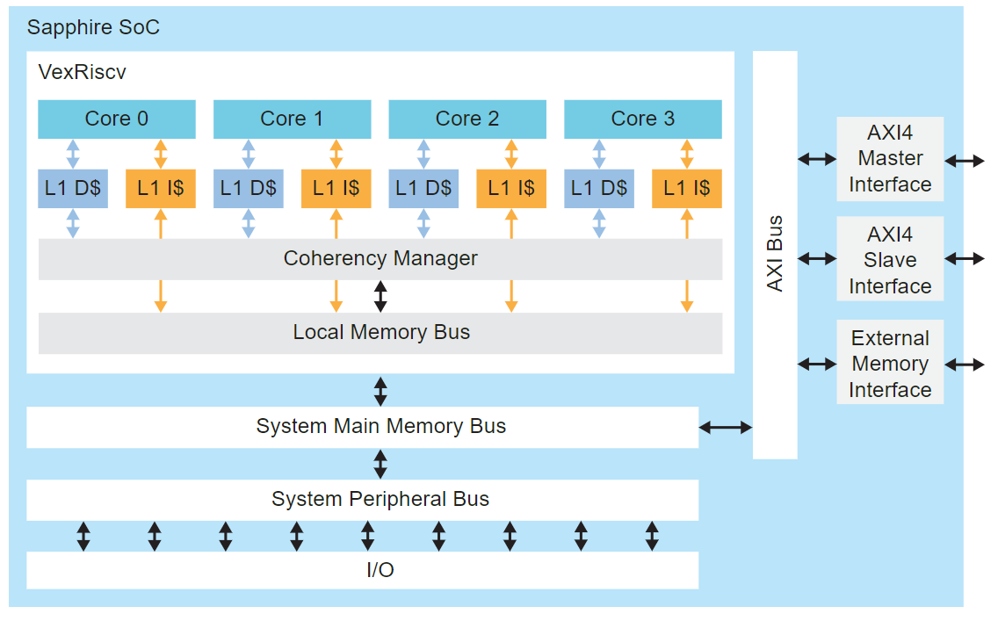
Sapphire SoC Multi-Core Block Diagram

Slide 8
Features
1 - 4 (user selectable) VexRiscv processor(s) with 6 pipeline stages (fetch, injector, decode, execute, memory, and write back), interrupts and exception handling with machine mode
20 - 400 MHz system clock frequency
1 - 512 KB on-chip RAM with boot loader for SPI flash
Memory controller for DDR or HyperRAM memories
Supports memory module sizes from 4 MB to 3.5 GB
User-configurable external memory bus frequency
1 half duplex AXI3 interface or 1 full duplex AXI4 interface (up to 512-bits) to communicate with the external memory
400 MHz DDR clock frequency, 800 Mbps
200 MHz HyperRAM clock frequency, 400 Mbps

Slide 9
Up to 2 AXI master channels for user logic, data widths from 32 to 512
1 AXI slave channel to user logic
Includes a floating point unit
Includes an optional Linux memory management unit
Includes a custom instruction interface with 1,024 IDs to perform different functions
Supports optional RISC-V extensions such as atomic and compressed

Slide 10
APB3 peripherals:
Up to 32 GPIOs
Up to 3 I²C masters
Clint timer
PLIC
Up to 3 SPI masters
Up to 3 user timers
Up to 3 UARTs with 115,200 baud rate
Up to 5 slave user peripherals
Up to 8 user interrupts

Slide 11
FPGA SUPPORT
The Sapphire SoC supports all Trion® FPGAs (except the T4) and all Titanium FPGAs, however, you may only be able to use some of the features in certain devices. For example, the DDR controller only works with FPGAs that have a hardened DDR controller block.

Slide 12
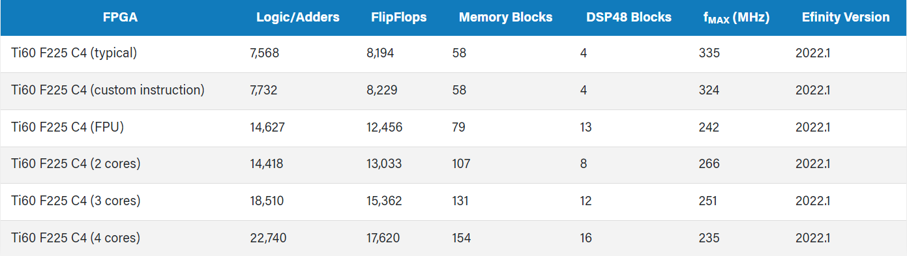
Titanium Resource Utilization and Performance:
The Sapphire is configurable. These table show the resource usage for various configurations.
Ti60 F225 Cached SoC with External Memory:

Slide 13
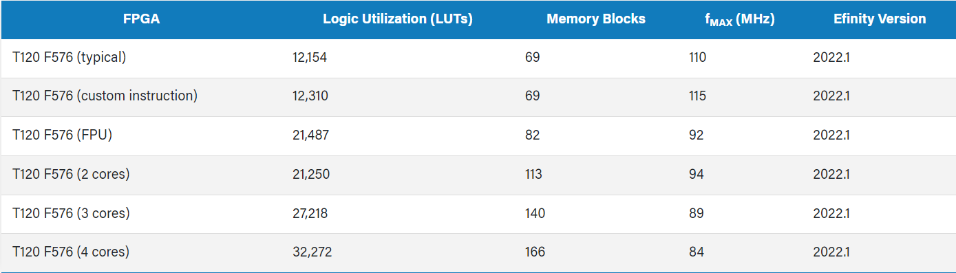
Trion Resource Utilization and Performance
The Sapphire is configurable. These table show the resource usage for various configurations.
T120 F576 Cached SoC with External Memory:

Slide 14
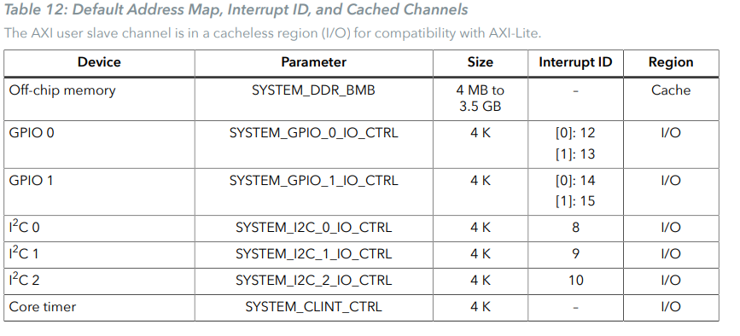
Address Map
Because the address range might be updated,Efinix recommends that you always refer to the parameter name when referencing an address in firmware, not by the actual address.The parameter names and address mappings are defined in /embedded_sw/<module>bsp/efinix/EfxSapphireSoc/include/soc.h.

Slide 15
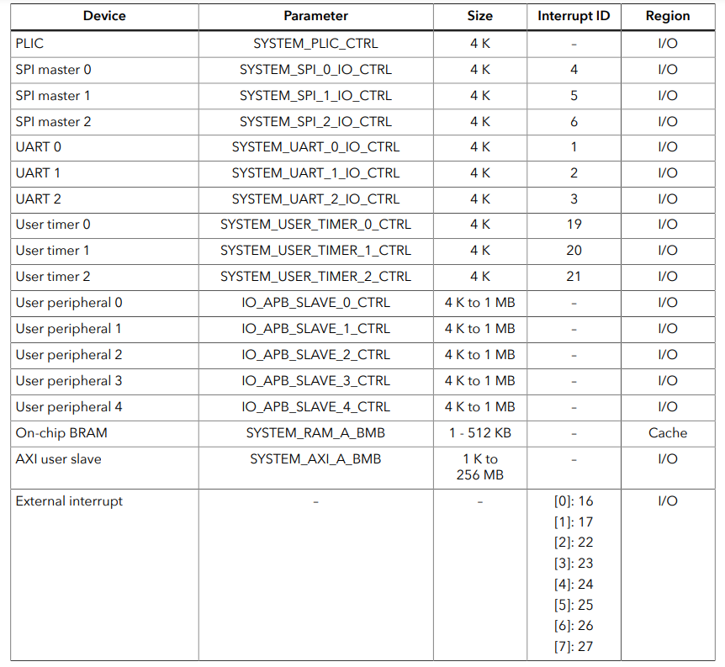

Slide 16
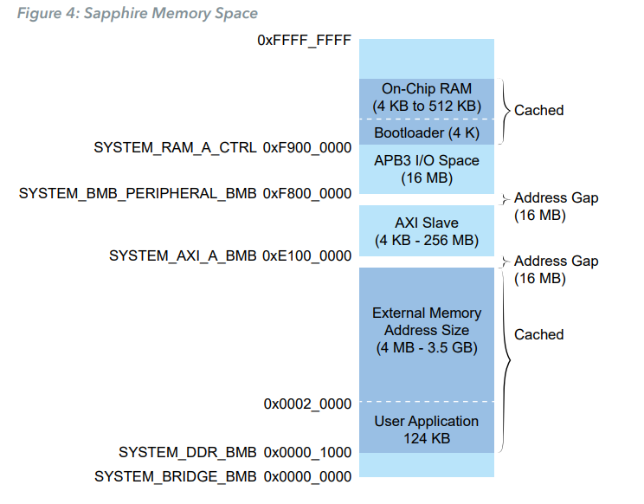
For the cached regions, the burst length is equivalent to an AXI burst length of 8.
For the I/ O region, the burst length is equivalent to an AXI burst length of 1.
The AXI user slave is compatible with AXI-Lite by disconnecting unused outputs and driving a constant 1 to the input port.
The following figure shows the default address map and the corresponding software parameters for modules in the memory space.

Slide 17
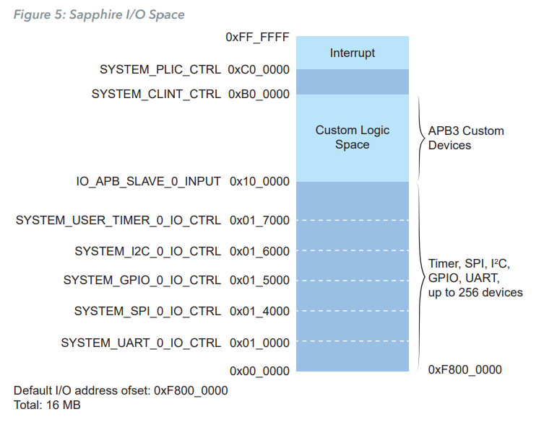
The following figure shows the default address map and the corresponding software parameters for I/O.

Slide 18
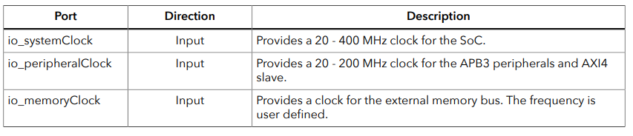
Flash Address :
When the FPGA boots up, the Sapphire SoC copies your binary application file from a SPI flash device to the DDR DRAM module, and then begins execution.
The SPI flash binary address starts at 0x0038_0000.
Clocks :

Slide 19
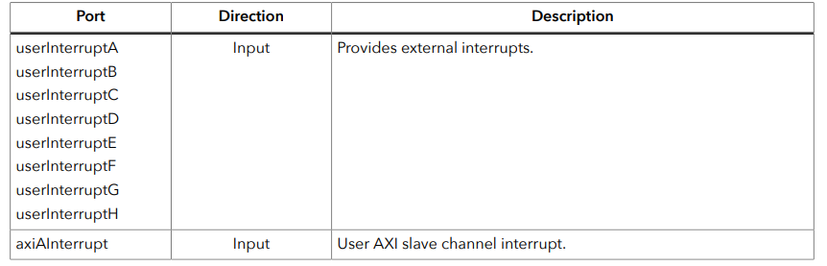
Interrupts :

Slide 20
Resets:
The Sapphire SoC has as master reset signal, io_asyncReset that triggers a system reset. Your RTL design should hold io_asyncReset for 10 ns to reset the whole SoC system completely. When you assert io_asyncReset, the SoC asserts:
io_systemReset, which resets the RISC-V processor, on-chip memory, and peripherals.
io_peripheralReset, which resets the APB3 peripherals and AXI4 slave.
io_memoryReset, which resets the memory controller, external memory module, I2C master and slave connected to the memory controller, and any user logic.
io_ddrMasters_0_reset, which responds to the reset for AXI master channel 0 and is synchronized to io_ddrMasters_0_clk.
io_ddrMasters_1_reset, which responds to the reset for AXI master channel 1 and is synchronized to io_ddrMasters_1_clk.

Slide 21
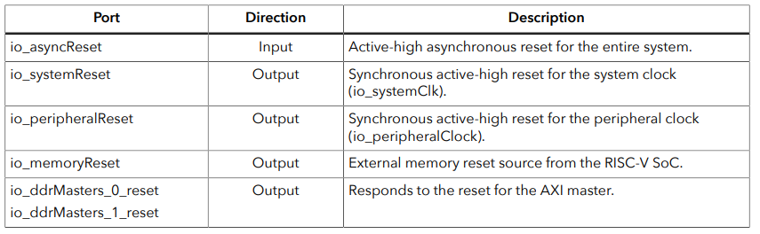
The SoC asserts the io_memoryReset, io_ddrMaster_0_reset, and io_ddrMaster_1_reset signals at the same time to allow the AXI masters access to the AXI cross bar once the reset completes.
Once io_systemReset goes low, the user binary code is executed.

Slide 22
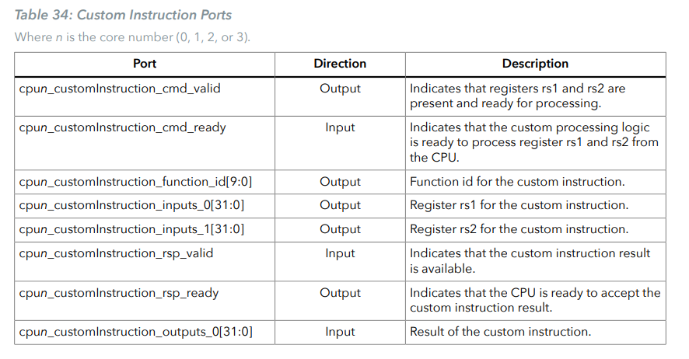
Custom Instruction Interface
The Sapphire SoC supports a custom instruction interface so you can accelerate software functions with custom hardware logic. The custom instruction supports R-type instructions, which provides two registers (rs1 and rs2) to custom instruction processing logic and up to 1,024 IDs to perform different functions.

Slide 23
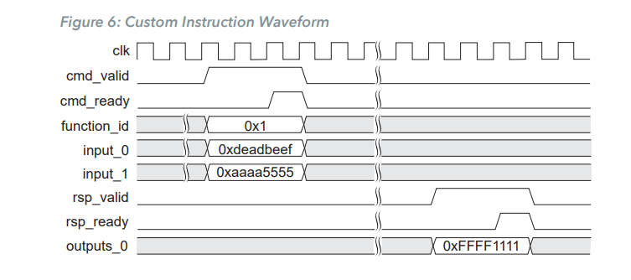

Slide 24
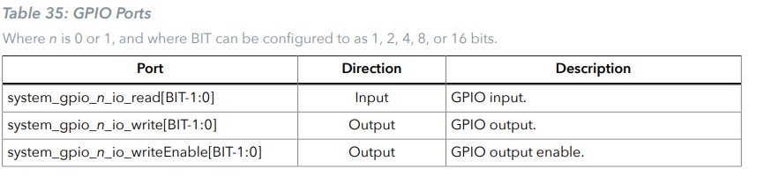
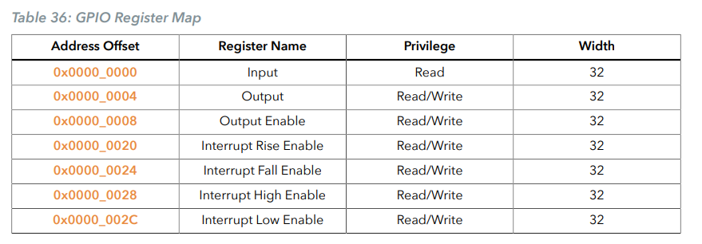
GPIO Peripheral Interface
Use the SYSTEM_GPIO_0_IO_CTRL or SYSTEM_GPIO_1_IO_CTRL parameter to reference the GPIO interface.

Slide 25
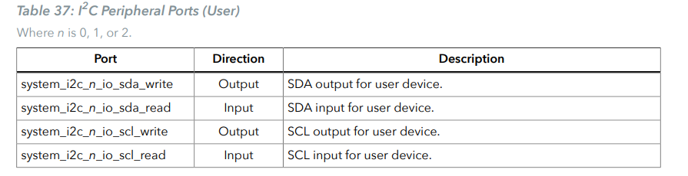

$I^{2}$C Peripheral Interface
The Sapphire SoC has up to 3 $I^{2}$C master/slave peripherals. You use the system_i2c_2* ports to calibrate the DDR DRAM memory; if you do not want to perform calibration, you can use this peripheral for your own purposes. Use these parameters to reference the interface:

Slide 26
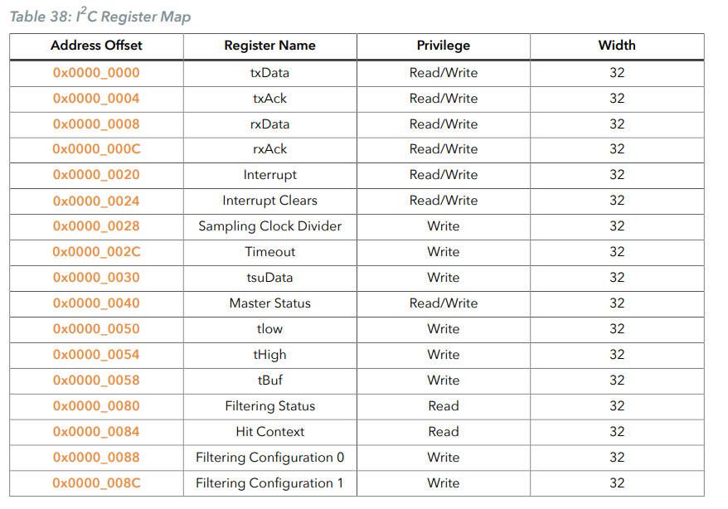

Slide 27
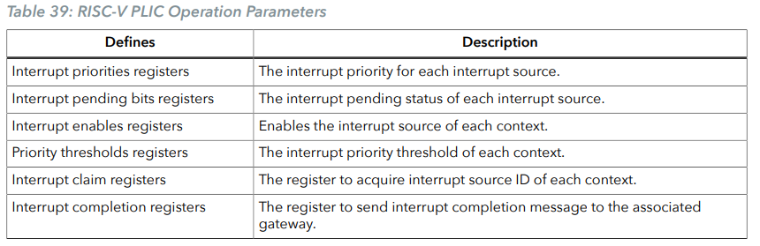
PLIC Peripheral Interface
Use the SYSTEM_PLIC_CTRL parameter to reference the interface PLIC interface.
The soc.h file contains a number of PLIC parameters to specify the interrupt ID for the various peripherals.

Slide 28
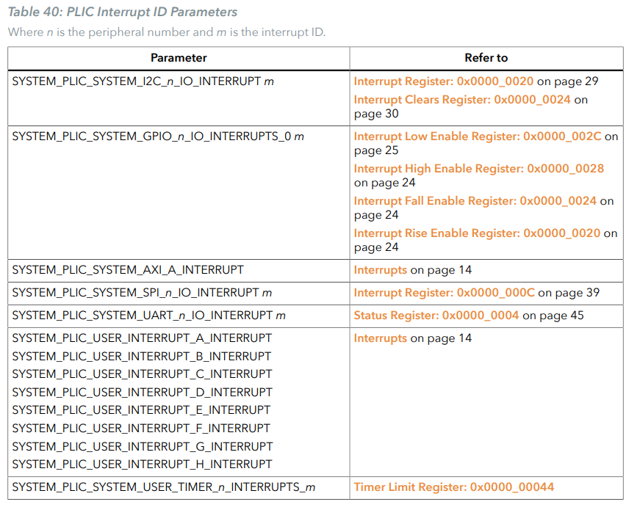

Slide 29
SPI Master Peripheral Interface
The SPI master peripheral interface supports traditional dual-line full-duplex mode as well as half-duplex mode in 2 and 4-wire SPI. The SPI data width is configurable up to 16 bits.
Half-duplex mode is only available when the SPI data width is configured as 8 or 16. When implementing the SPI peripheral in traditional dual-line mode, use the data_0 ports as MOSI and and the data_1 ports as MISO.
Use these parameters to reference the interface:
SPI master 0—SYSTEM_SPI_0_IO_CTRL
SPI master 1—SYSTEM_SPI_1_IO_CTRL
SPI master 2—SYSTEM_SPI_2_IO_CTRL

Slide 30
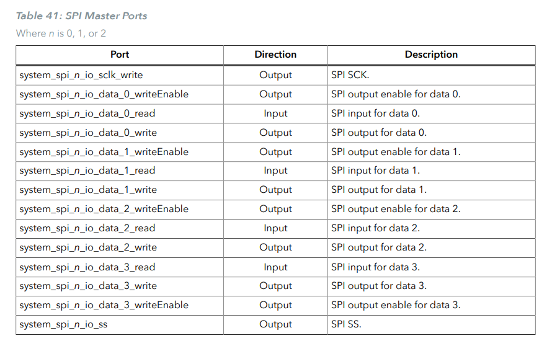

Slide 31
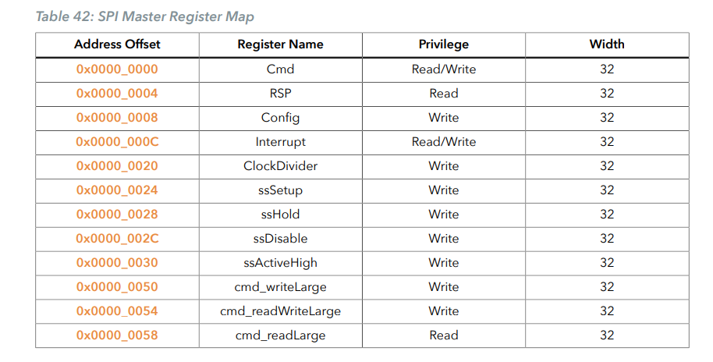

Slide 32
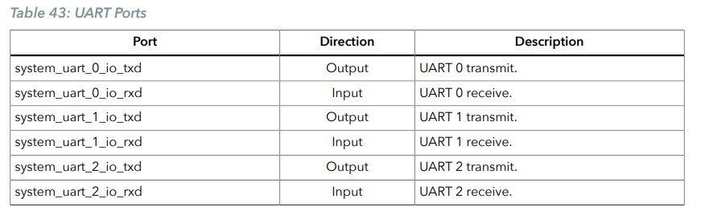
UART Peripheral Interface
You can configure up to 3 UART peripherals. Each UART peripheral runs at 115200 baud and supports 8 data bits, no parity, and 1 stop bit. Use these parameters to reference the interface:
UART 0—SYSTEM_UART_0_IO_CTRL
UART 1—SYSTEM_UART_1_IO_CTRL
UART 1—SYSTEM_UART_2_IO_CTRL

Slide 33
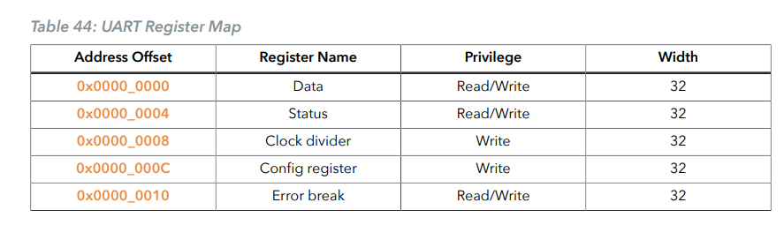

Slide 34
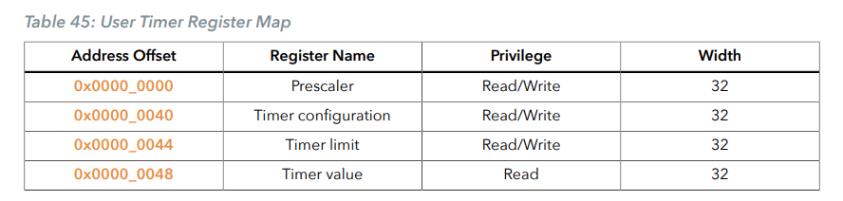
User Timer
You can configure up to three user timers so you can perform actions such as timestamp and interrupts without using the core timer. You can adjust the interval period to generate a timer tick pulse by setting the prescaler register, based on the system clock or peripheral clock (if enabled).

Slide 35
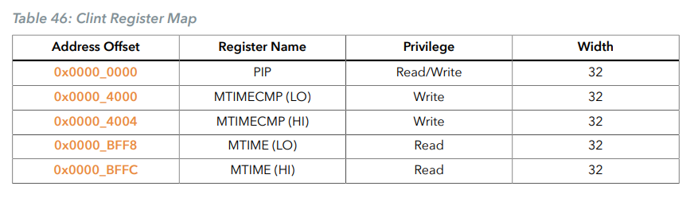
Clint
The core local interrupt (clint) consists of a 64-bit realtime counter, which is driven by io_systemClk or io_peripheralClk (if enabled). The clint counter value increases monotonically. Clint is also responsible for handling the control and status via software interrupt.

